Slide 1
Your Second Hack: Part 1
Ryan Coon
CYB-610
Professor Ian Standefer
April 16, 2025

Slide 2
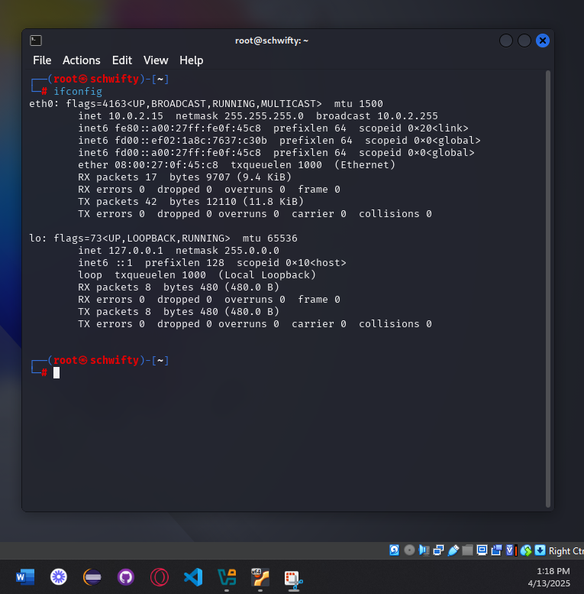
Network Enumeration

Slide 3
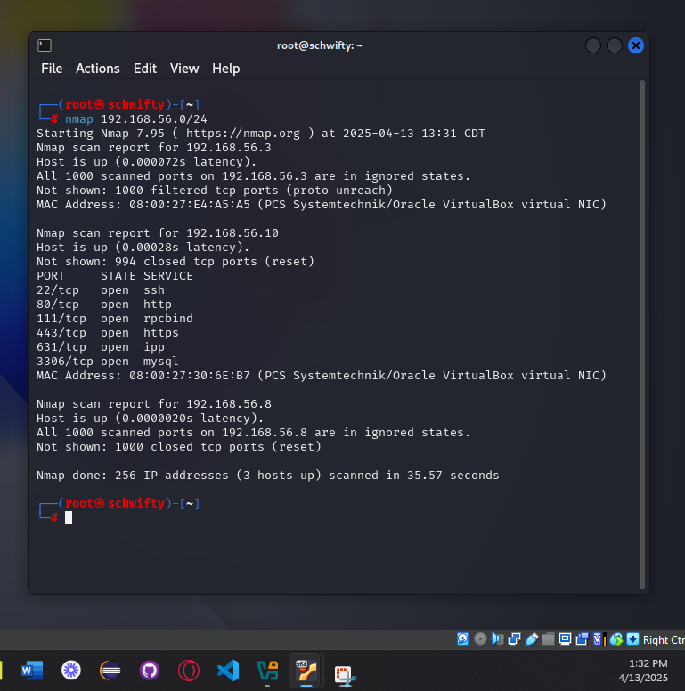
Network Enumeration

Slide 4
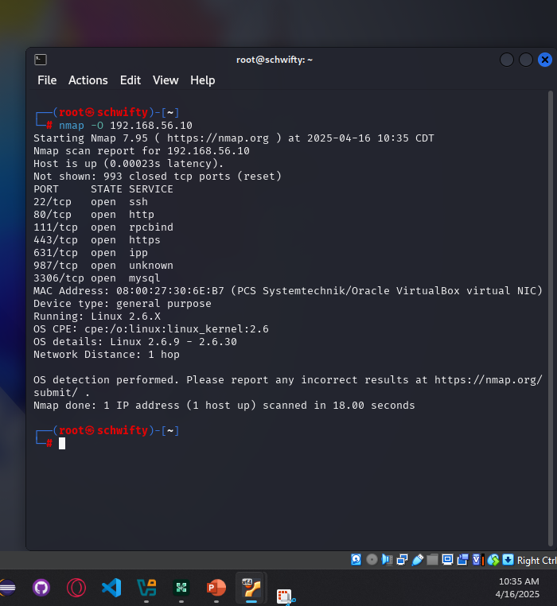
Network Enumeration

Slide 5
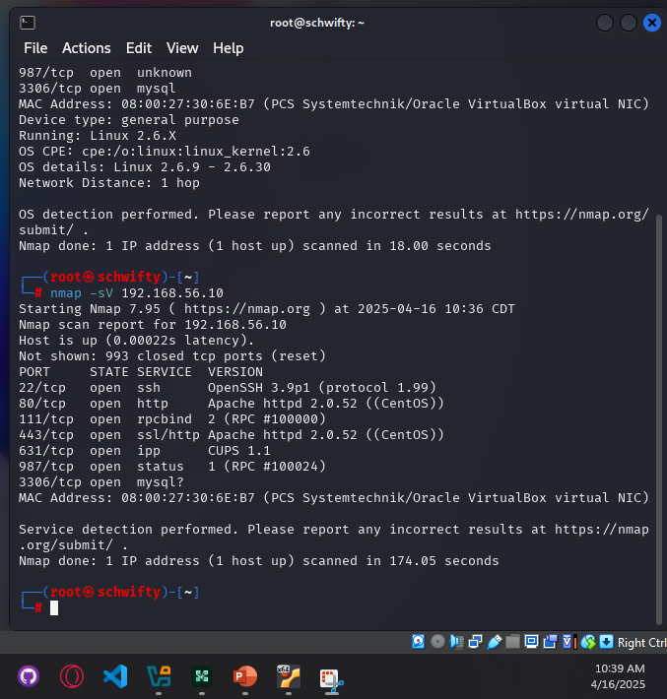
Network Enumeration

Slide 6
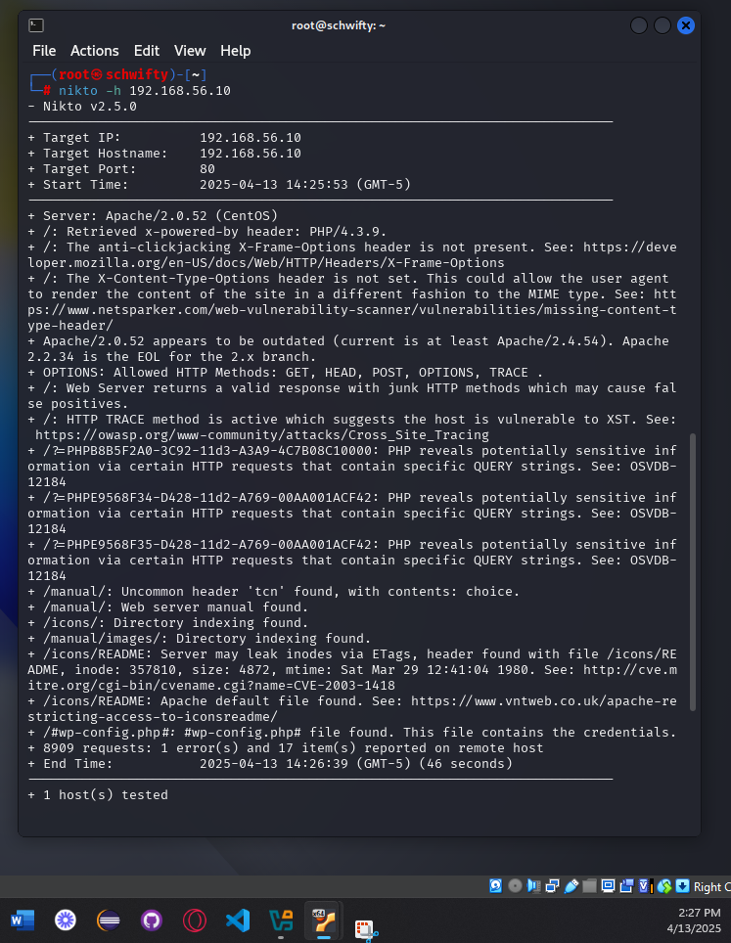
Nikto Scan
Nikto is a simple, open-source web server scanner that examines a website and reports back vulnerabilities that it found which could be used to exploit or hack the site. Also, it's one of the most widely used website vulnerabilities tools in the industry, and in many circles, considered the industry standard.

Slide 7
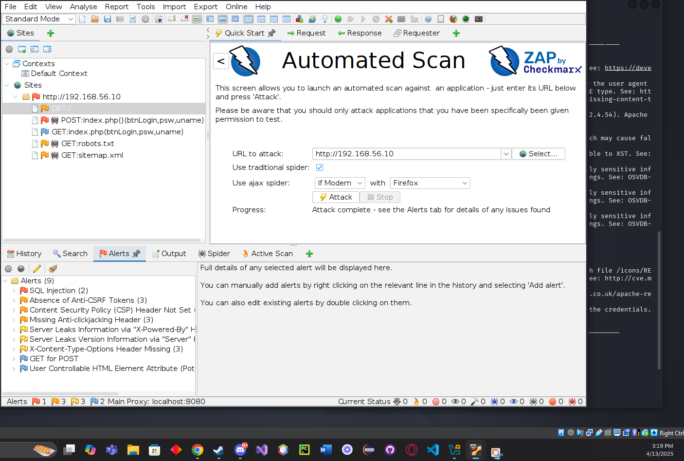
OWASP Zap
OWASP ZAP is a multipurpose scanning tool that helps penetration testers and bug bounty hunters for finding vulnerabilities with a web app. ZAP stands for Zed Attack Proxy. It is loaded with proxy, active and passive vulnerability scanners, fuzzer, spider, HTTP request sender & other types of searches.

Slide 8
Nikto Scanner vs. OWASP Zap
Nikto is a command-line penetration testing and automated scanning tool available at no cost. Built in Perl, Nikto allows users to configure scans through various switches, such as the '-evasion' option, which employs techniques to avoid detection by firewalls and intrusion detection systems. The tool's plugin architecture enables it to identify vulnerabilities based on CVE details. Its lightweight design makes it suitable for use on systems with lower specifications.
The OWASP ZAP proxy is a comprehensive, open-source tool for web application penetration testing, actively supported by the OWASP community. Key features include a man-in-the-middle proxy, spidering, active and passive scanning capabilities, an in-app browser for manual testing, and dedicated scanners for web sockets and SSL. ZAP also provides robust support for web services and API scanning, and users can extend its functionality through a marketplace of add-ons.

Slide 9
Cross-Site Request Forgery(CSRF)
A Cross-Site Request Forgery (CSRF) attack allows an attacker to hijack a user's authenticated session, forcing them to unknowingly submit requests to a web application. The vulnerability arises when the application trusts the user's authentication without verifying the origin of the request. If the application cannot differentiate between a genuine request and one initiated by an attacker, the CSRF attack is successful, potentially leading to unauthorized actions performed on the user's behalf.

Slide 10
Cross-Site Scripting(XSS)
XSS attacks are a significant web security threat, involving the injection of malicious scripts into trusted websites. Attackers exploit vulnerabilities in web applications to inject malicious code, typically targeting a user's web browser. The root cause of XSS vulnerabilities is the failure of web applications to properly validate or encode user-supplied input before including it in their output, making these attacks a widespread concern.

Slide 11
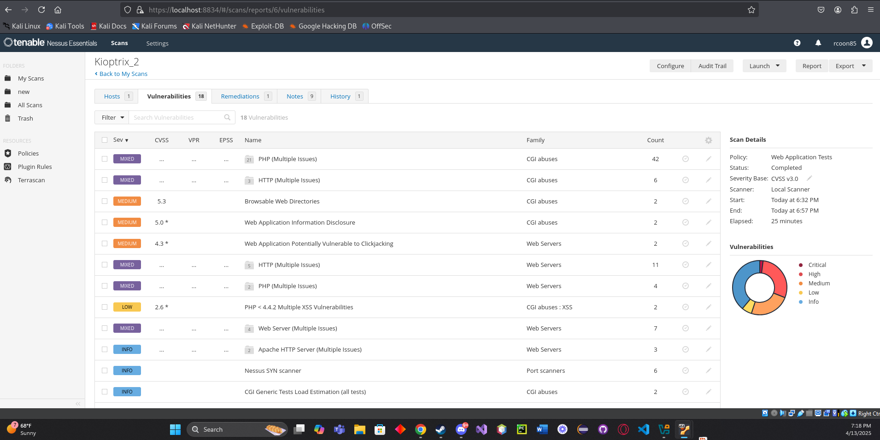
Nessus Scan

Slide 12
10 Vulnerabilities Discovered
PHP-unsupported version detection
Outdated software
My SQL database
HTTP- CGI generic ssi injection
Web application information disclosure
Browsable web directories
DNS Issues
Missing content security policy framework
Missing x framework options
Trace/Track Methods allowed

Slide 13
Hypothesis
The Kioptrix 2 machine presents a significant security risk due to numerous vulnerabilities identified through network analysis and scanning. These vulnerabilities include a high susceptibility to injection attacks and web exploits, compounded by the absence of key security components and the use of outdated software.
The attack vector I would use for the Kioptrix 2 system would be injection.

Slide 14
Application of tools and techniques for identifying vulnerabilities
My approach involved a multi-stage scanning process. Initially, network enumeration was used to identify fundamental vulnerabilities. Following this, I utilized Nikto and OWASP ZAP, leveraging their unique scanning techniques. The results were then analyzed, and the most critical vulnerabilities were targeted with a Nessus scan for a more in-depth assessment.

Slide 15
Vulnerability Disclosure
Vulnerability disclosures can be controversial because vendors often prefer to wait until a patch or other form of mitigation is available before making the vulnerability public. However, researchers, cybersecurity professionals and enterprises whose sensitive data or systems may be at risk prefer that disclosures be made public as soon as possible. The goal is to balance the need to protect users from harm with the vendor's right to fix the vulnerability privately. Responsible disclosure prioritizes remediation, minimizing the risk of widespread damage and exploitation. Public disclosure should be the last resort, used only when necessary to protect users from significant harm.

Slide 16
Vulnerability Hypothesis and Root Cause
Injection flaws represent a critical security vulnerability where an attacker can introduce malicious code into an application. This injected code is then transmitted to another system, potentially compromising both the application's backend infrastructure and any other clients interacting with the vulnerable application.
Many web applications integrate with operating system features, external programs, and process user-submitted data queries. When an application constructs external requests using data from HTTP requests, rigorous scrubbing and validation of the message are essential. Otherwise, attackers can inject harmful elements, such as special characters, malicious commands, or code modifiers, potentially compromising the syst
Although injection attacks are not technically difficult to execute, readily available tools can identify these vulnerabilities. Attackers can exploit these flaws to access, damage, or destroy database contents, compromise backend systems, or target other users.
Successful injection attacks may completely compromise or destroy a system. It is important to test for and protect against these types of attacks.
Research of the vulnerability is the best way to figure out root cause and the start of the vulnerability

